Slide 1
The Effect of the change in the Corporate Income Tax (CIT) threshold to Indonesia’s Economy
Putri Istika Ratu Siregar

Slide 2
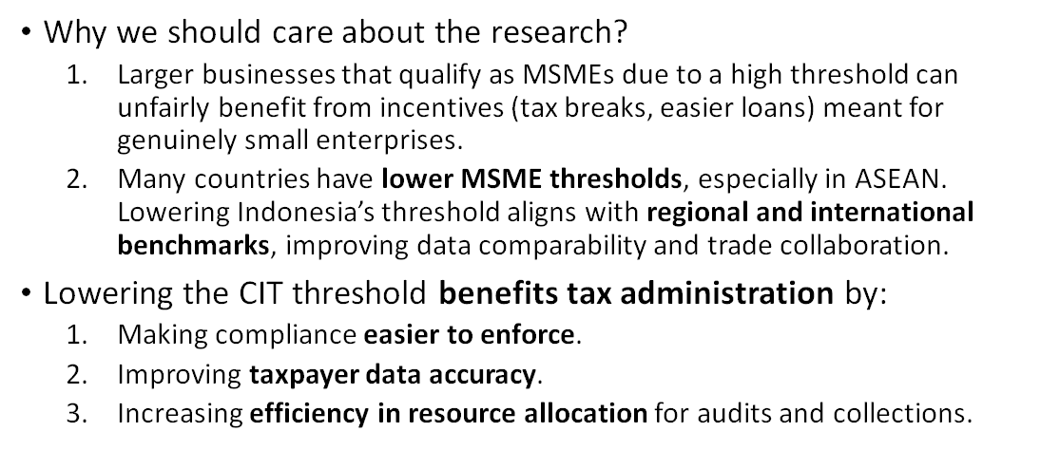
Background

Slide 3
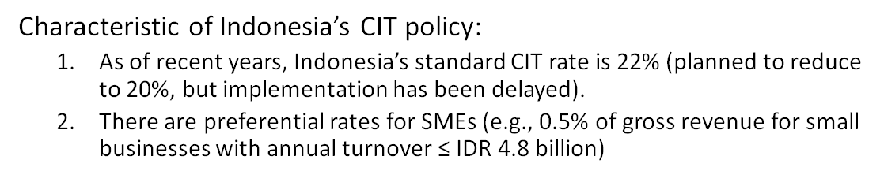
Background

Slide 4
Research Question
“How does a change in the Corporate Income Tax (CIT) threshold affect Indonesia’s fiscal sustainability, macroeconomic performance, and the distribution of capital and income between small and large firms over the long term?”

Slide 5
Data/Model/Calibration Tools
•Calibration::Calibrated to Indonesia’s baseline GDP, tax revenue, public debt, and interest rates.
•Firm Data:Differentiated between small and large firms, based on capital stock, tax rates, and size thresholds.
•Time Horizon:Projection from 2025 to 2045 for most variables; Model.

Slide 6
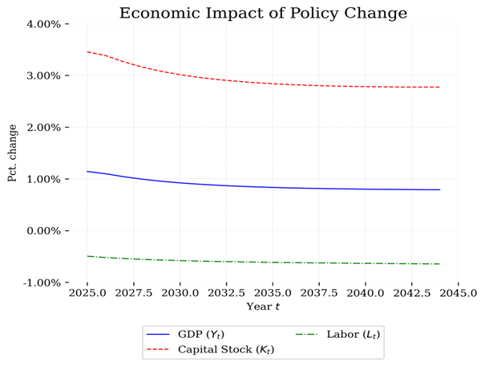
Results
Capital (K):
•↑ ~3.5% initially, stabilizing at ~2.8% above baseline
•Firms invest more in capital, likely due to efficiency gains and broader tax base.
GDP (Y):
•↑ ~1.1% initially, settling at ~0.8% above baseline
•Output grows modestly, driven by increased investment and improved resource allocation.
Labor (L):
•↓ ~0.4%, stabilizing at ~0.5% below baseline
•Slight decline in labor usage, possibly from firms substituting capital for labor.

Slide 7
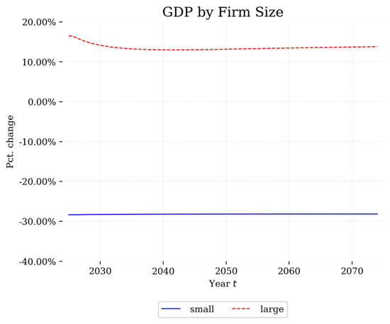
Results
Small firms' GDP contribution drops by ~30%. → Lower CIT threshold means more small firms taxed at full rate, reducing their growth, investment, and output.
Large firms' GDP contribution rises by ~15%. → Large firms gain market share, scale up production, and benefit from resource reallocation.

Slide 8
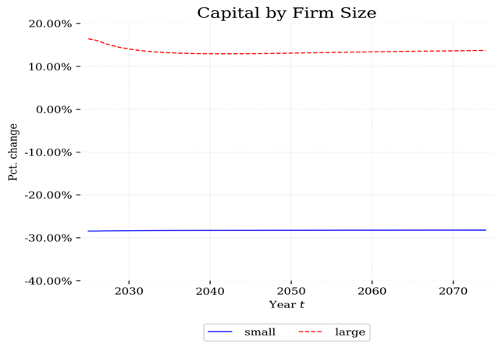
Results
Small firms experience a sharp and persistent decline in capital (~30% lower) after the reform.
Large firms experience a significant capital increase (initially around +17%, stabilizing near +13%).

Slide 9
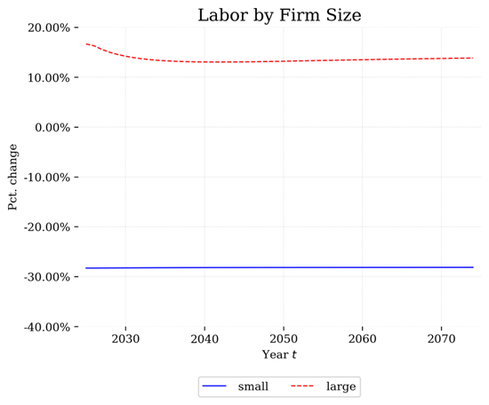
Results
Small Firms: –30% Labor
•Due to losing preferential tax treatment, small firms likely cut hiring or downsize, reducing labor demand sharply.
•This aligns with their GDP drop in your previous chart — small firms are contracting.
Large Firms: +15% Labor
•Large firms expand under the policy change, hiring more workers.
•Growth in large firms absorbs some of the labor shed by small firms.

Slide 10
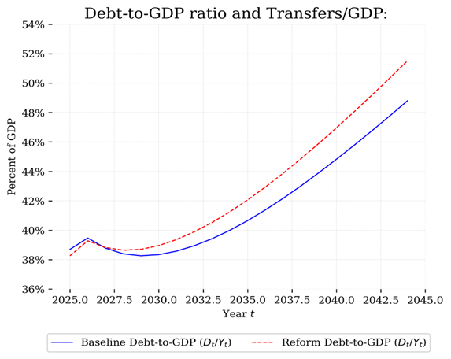
Results
After the policy reform, government debt grows faster relative to GDP compared to the baseline.
Despite GDP gains (as seen in earlier graphs), revenue loss or increased spending likely causes higher deficits.
Tax revenue may decline due to contraction of small firms (losing SME tax advantage may reduce their output/tax base).

Slide 11
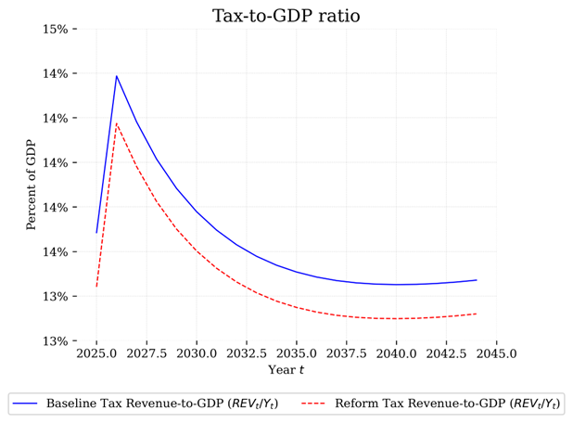
Results
Tax revenue as % of GDP is lower under the reform at all times.
The gap widens over time, meaning the policy reduces the government's ability to collect tax relative to economic output.
Likely cause: Small firms lose tax benefits, reduce output, and pay less tax; large firms gain but don’t fully offset the loss.

Slide 12
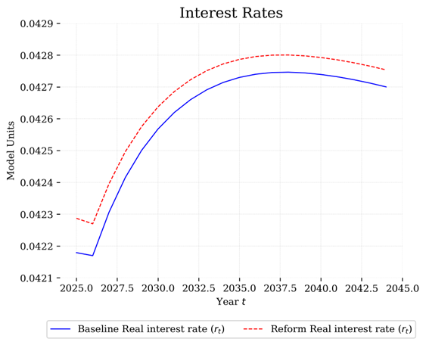
Results
Real interest rates are slightly higher under the reform scenario.
This reflects greater demand for capital—likely due to larger firms investing more, as capital stock increased under the reform.
Higher interest rates can also be a response to higher government debt (as seen in the Debt-to-GDP ratio), increasing risk or borrowing costs.

Slide 13
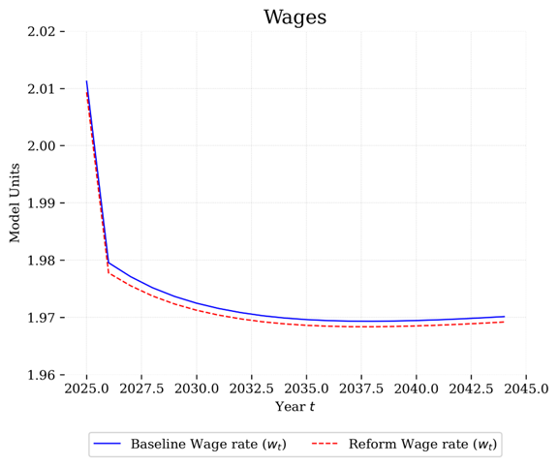
Results
Wages are slightly lower under the reform scenario compared to baseline.
This suggests that the lower CIT threshold reform reduces labor demand slightly or shifts the labor-capital balance, favoring capital.
The reform may have encouraged capital accumulation (as seen in earlier graphs), but labor use (and hence wages) slightly declined.

Slide 14
Conclusion
Summary:
•Debt-to-GDP Ratio: Increases significantly under reform due to lower tax revenue and higher borrowing needs.
•Tax-to-GDP Ratio: Decreases under reform, reflecting reduced government revenue from lower CIT rates.
•Interest Rates: Slightly higher in the reform scenario, driven by increased government debt and borrowing.
•Wages:Slight decline under reform, indicating mild negative effects on labor income and productivity.
•Capital by Firm Size
•Large firms: Capital increases by ~13–17%, benefiting from higher thresholds.
•Small firms: Capital decreases by ~30%, facing reduced competitiveness or support.
•Overall:Reform leads to higher fiscal pressure, uneven firm growth, and mild economic strain on wages and investment.

Slide 15
Conclusion
Weakness and deficiensies
1.Results depend heavily on parameter calibration; Indonesian-specific data may be limited or outdated, reducing real-world accuracy.
2.The model may over-simplify firm behavior, especially differences between small and large firms in terms of capital allocation, technology adoption, and access to finance.
3.Assumes fixed behavioral responses to tax changes, ignoring dynamic adaptations like tax evasion, avoidance, or changes in investment strategy over time.

Slide 16
Conclusion
Future direction:
1.Use Indonesian firm-level tax and financial data to refine the model, improving accuracy on CIT threshold impacts across sectors.
2.Model adaptive firm behavior over time (e.g., investment shifts, tax planning) in response to CIT reforms for more realistic outcomes.
3.Evaluate CIT threshold changes alongside other policies (e.g., VAT reforms, subsidies, digital tax) for holistic policy insights.

